Slide 1

HAPPINESS ANYWHERE VOOR ICI PARIS XL
TEAM SAMENSTELLING

Slide 2
Hallo!

Slide 3
HALLO HAPPINESS
Wat leuk dat jullie ons hebben gevraagd om een voorstel op papier te zetten op basis van jullie RFQ.

Slide 4
HALLO HAPPINESS
Als antwoord hebben wij een uniek Happiness Anywhere team samengesteld voor ICI PARIS XL.

Slide 5
HALLO HAPPINESS
Een mix van Nederlandse, Vlaamse en Franse ‘native speakers’ met het juiste talent en ervaring om het beste werk te kunnen leveren op basis van jullie uitdagingen.

Slide 6
1
Happiness Anywhere team

Slide 7
TEAM SET UP
CORE BRAND TEAM (HA & HB)
Eindverantwoordelijk voor al het werk (brand strategy, campagne ontwikkeling, key assets development & productie, overzien en aansturen alle markten)
EXECUTIE TEAM NEDERLAND & BELGIE (LUX & BE)
DAY TO DAY TEAM NEDERLAND & BELGIE
Verantwoordelijk voor alle uitwerking & productie in Nederland & België – in 3 talen: Nederlands, Frans, Vlaams

Slide 8
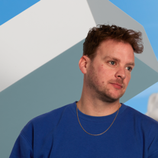
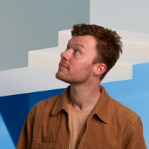
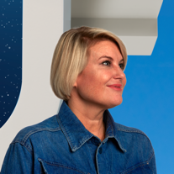
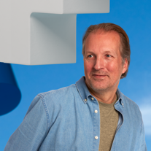
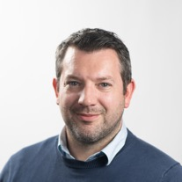
TEAM SET UP
CREATIVE
JOEY BOETERS
NIK SLUIJS
Creative partner
& Co-founder Amsterdam
Creative Director
& Co-founder Amsterdam
IRIS MINNEMA
Business partner
& Co-founder Amsterdam
Creative
Management
DAAN DE RAAF
MATTIAS
VERMEIRE
Strategy partner
& Co-founder Amsterdam
Business/Account Director
Happiness Anywhere
Brussel
BUSINESS
STRATEGY

Slide 9





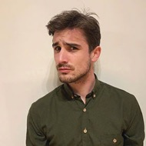
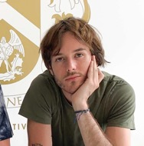
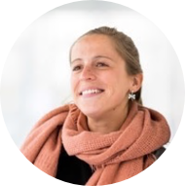
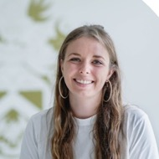
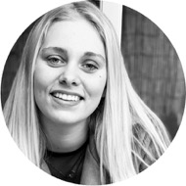
TEAM SET UP
CREATIVE
STRATEGY
BUSINESS
CORE TEAM
NIK SLUIJS
JOEY BOETERS
DAAN DE RAAF
IRIS MINNEMA
MATTIAS VERMEIRE
Creative partner
& Co-founder
Creative partner
& Co-founder
Strategy partner
& Co-founder
CEO
& Co-founder
Business / Account Director
& Partner
EXECUTION TEAM
GIL GAUNIAUX
THIBAUT CASTAING
JULIE HENDRICKX
MORGANE JUGET
AXELLE VERRYDT
Sr Creative
Sr Creative
Sr Account Manager
Project coordinator/AE
Project coordinator/AE
CONCEPT, DESIGN, DTP, MOTION EN PRODUCTIE SUPPORT PER PROJECT
via de ondersteunende afdelingen binnen Happiness en waar nodig via ‘friends of Happiness’ (3rd parties)

Slide 10
2
Onze ‘way of working’

Slide 11
TERUGKERENDE MEETINGS (MET KLANT)
SOORT MEETING/ ACTIVITEIT | WANNEER | LOCATIE | WIE VAN KLANT? | WIE VAN BUREAU?
Wekelijkse status meetings | Iedere dinsdag (60 min) | Alternerend Call & F2F (2 keer per maand op locatie in NL of Belgie) | Key team members | Iris, Mattias, Julie
Maandelijkse rapportage gespendeerde uren | 3 weken na maand afsluiting | Via email – te bespreken tijdens de wekelijkse status | Team lead | Iris & Mattias
Kwartaal strategie sessie (als doorgegeven in RFQ) | Ieder kwartaal (4 x per jaar) | TBD | Volledig team? | Account en strategie
Jaarlijkse 'After Cannes’ Bureau sessie (Inspirerende Creatieve dag – voor team building en inspiratie) | September | Vilvoorde | Volledige team | Volledige team
Jaarlijkse evaluatie | Januari | Bij ICI PARIS XL | Key team members | Iris, Mattias, Daan

Slide 12
TERUGKERENDE MEETINGS (INTERN)
SOORT MEETING/ ACTIVITEIT | WANNEER | LOCATIE | WIE?
Wekelijkse SCRUM (Interne status – bespreken alle lopende projecten) | Iedere maandag (45 min) | Call | Key team members
Bi-weekly korte catch up met media en andere key partners | Om de week op woensdag (30 min) | Call | Afhankelijk van wat er loopt

Slide 13
JAARPLANNING
Deze planning zullen we samen invullen
Jan | Feb | Mar | Apr | May | Jun | Jul | Aug | Sept | Oct | Nov | Dec

Slide 14
DE WOW
De project ontwikkeling fasen die we aanhouden.

Slide 15
DE WOW
The Phases
2. Concept & Content Platform
Proof of Concept on key deliverables
3. Content creation
Create the ‘Master Content’ on key touchpoints
4. Content execution
Detailed Content Execution & Planning
5. Production
(Pre)Production & Mediabuying
6. Dashboarding
Measure, Analyse, Optimise
1. Strategy

Slide 16
DE WOW
Phases & Tiers
2. Concept & Content Platform
Proof of Concept on key deliverables
3. Content creation
Create the ‘Master Content’ on key touchpoints
4. Content execution
Detailed Content Execution & Planning
5. Production
(Pre)Production & Mediabuying
6. Dashboarding
Measure, Analyse, Optimise
1. Strategy
TIER 1 CAMPAIGNS
360° concept & content providing + production
We are looking for a new platform/idea on which we can create and produce great content.
TIER 2 CAMPAIGNS
Creating new content on an existing ‘concept & content platform’. Or creation of content (without a platform)
In this phase, there is still the need for an ‘idea’..a concept..however small it may be
TIER 3 CAMPAIGNS
Content adaptations or pure executional content
No ideas are asked here, just a great execution or adaptation or copy or newsletter etc…

Slide 17
1
Team bios &
relevante ervaring

Slide 18

Meet Daan de Raaf
Strategy Partner & Co-Founder
Daan has a history of being the odd one out in the organizations he worked for, but never out of place. He was a very commercial person among scientists, a communications professional among management consultants and the brand & business consultant in a creative communications agency. He combines rigor and imagination. He loves to cook, is a padel aficionado and boss to Bobbie the office dog.
Work experience
Happiness Amsterdam
Strategy Partner & Co-Founder / Jan 2023 - present
Erasmus University Rotterdam
Assistant Professor Marketing / 2000 - present
Dare! Strategy
Owner / 2014 - 2023
JWT Amsterdam
Executive Strategy Director / 2015 – 2018
DDB & Tribal Worldwide, Amsterdam
Strategy Director & Head of Strategy / 2002 - 2014
Van Spaendonck Management Consultants
Senior Consultant / 1997 - 2002
“Generating happiness is the way to memorable and effective work”
Relevant experience
23 years working together at the Erasmus University with L'Oréal on their Brandstorm competition, lecturing and coaching students on beauty related business challenges covering all categories and brands. As a freelancer I did several projects for Kruidvat. At DDB I worked for VSM for several years.

Slide 19

Meet Iris Minnema
CEO & Co-Founder
Iris is a realistic optimist with a drive for building brands with strong creative ideas and solutions. She is a people person, a team builder & team player, loves to simplify complex issues and processes, is a motivator, business sparring partner, efficiency driver and happy cat mom.
Work experience
Happiness Amsterdam
CEO & Co-Founder / Jan 2023 - present
DDB Unlimited Amsterdam
Global Business Director / May 2019 - Dec 2022
DDB Dubai
Managing Director / June 2017 - April 2019
Business Director / Feb 2014 - June 2017
Group Account Director/ July 2013 - Feb 2014
Face to Face UAE
Group Account Director AI /March 2013 - July 2013
DDB Amsterdam
Account Director & Sr Account Manager / Feb 2007 - Sept 2012
Grey Amsterdam
Account Manager / Sept 2004 - Feb 2007
The Communication Company (TCC) Amsterdam
Account Manager & AE / Nov 2001 - Sept 2004
Van Soelen Advertising - Hoorn
Account Executive/ Nov 2000 - Nov 2001
“Happiness is about your mindset and appreciation of the people you surround yourself with”
Relevant experience
With over 20 years of experience, Iris has worked on Global, Regional and local brands in all possible sectors. She has a lot of FMCG experience (P&G, Unilever, GSK), but her most relevant Beauty & Fashion experience is for: Sephora, Johnson & Johnson (Neutrogena, Clean & Clear) and the Fashion Retailer C&A.

Slide 20
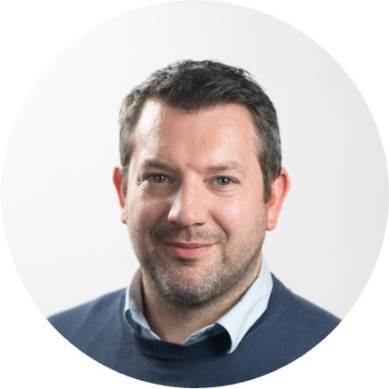

Meet Mattias Vermeire
Business / Account Director & Partner
Mattias is the geek of our bunch. He’s always interested in the newest tech & innovations, while his heart beats for real good creation & communications. Mattias is a real team player, loves to take people by the hand and share his experience in activations & digital.
Work experience
Languages
Business Director
2019 - present | Happiness
Account Director
2015 - 2019 | Publicis Brussels
International Client Manager
2012 - 2015 | Emakina
Account Manager
2011 - 2012 | Kunstmaan
Account Manager
2007 - 2011 | Wanabe
Account Executive
2006 - 2007 | ARC Worldwide
Mattias is fluent in Dutch, French and English
Awards
1 Silver Effie – long term behavioural campaign
2 Cannes Lions
6 Mixx Awards
7 Eurobest Awards
1 Gold Boa Award
1 Gerety Award
“Everything is connected.”
Relevant experience
Mattias’ experience in Sales promotions & activations, combined with his communication & digital background, allow him to be relevant in every step of your customer journey as he has done for Danone (Activia), Kellogg’s (Special K), Unilever (Dove, Yunomi, VO5, Neutral …), Procter & Gamble,… and many more.
Education
Marketingcommunication Erasmus Hogeschool Brussels

Slide 21

Meet Nik Sluijs
Creative Partner & Co-Founder
Nik dropped out of TU Delft Architecture to become an internationally awarded creative. Still applying the same analytical and creative problem solving skills, except without having to calculate whether his creations will actually defy physics.
Work experience
Happiness Amsterdam
Creative Partner & Co-founder / March 2023 - present
Fitzroy Amsterdam
Creative Director / May 2022 - Feb 2023
Wunderman Thompson Amsterdam
Senior Creative / Jan 2020 - May 2022
INDIE Amsterdam
Senior Creative / May 2017 - Jan 2020
Duval Guillaume Antwerp & Brussels
Senior Creative / Jun 2015 - May 2017
Fitzroy Amsterdam
Creative / Jan 2014 - Jun 2015
N=5 Amsterdam
Junior Creative / Sep 2011 - Dec 2013
Mortierbrigade Brussels
Junior Creative / 2011
Selmore Amsterdam
Junior Creative / 2010
“An ad can be anything, so why not add some happiness to people’s lives and make it useful or entertaining?”
Relevant experience
LO Care, Hero Baby, ByBorre, Puma Fragrances, among others

Slide 22
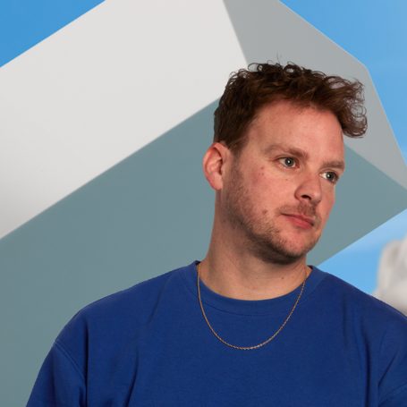
Meet Joey Boeters
Creative Partner & Co-Founder
Growing up in the Tel Sell era, Joey always wanted to become an inventor. But after failing to invent the next Quick ’n Brite or Boogy Bass, he guided his creativity elsewhere: Advertising. Joey aims to do advertising like Dennis Bergkamp did football. Because solving problems makes people content, but solving problems in a creative and surprising way makes people happy.
Work experience
Happiness Amsterdam
Creative Partner & Co-founder / March 2023 - present
Fitzroy Amsterdam
Creative Director / May 2022 - Feb 2023
Wunderman Thompson Amsterdam
Senior Creative / Jan 2020 - May 2022
INDIE Amsterdam
Senior Creative / May 2017 - Jan 2020
Duval Guillaume Antwerp & Brussels
Senior Creative / Jun 2015 - May 2017
Fitzroy Amsterdam
Creative / Jan 2014 - Jun 2015
Roorda Reclame
Creative / Jul 2011 - Jan 2014
Combat
Junior Creative / Dec 2010 - Mar 2011
Bureau Kellerman
Junior Creative / May 2009 - Nov 2010
Gummo
Junior Creative / May 2008 - May 2009
“Happiness is as much the journey as it is the destination.”
Relevant experience
LO Care, Hero Baby, ByBorre, Puma Fragrances, among others

Slide 23
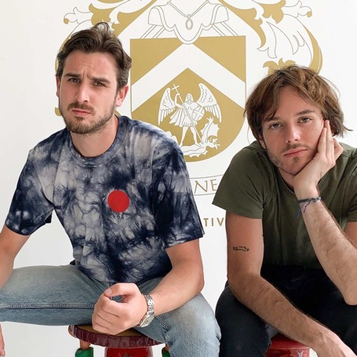
Meet Gil & Thibaut
Sr Concept providers
Experience
Languages
Concept providers
2021 - present | Happiness Brussels
Concept providers
2020 - 2021 | TBWA Belgium
Concept providers
2018 - 2019 | Federate
Gil & Thibaut are native French speakers with a very good knowledge of English.
Awards
1 Cannes Lion
3 Eurobest Awards
1 Youtube Awards
5 CCB
‘The power of a group is to learn from each other. Whether there are 2 of us or 1000’
Education
Relevant Experience
Master in Advertising (G)
Haute École Francisco Ferrer
Master in Art direction (T)
Sup de Pub
Marktplaats, Canon, VOO, Spa, Bebat

Slide 24
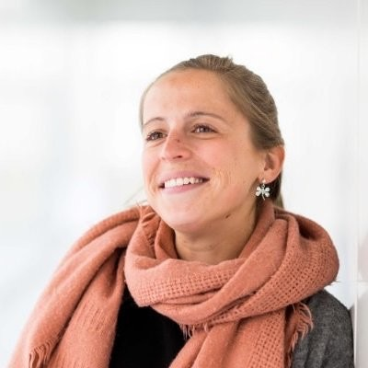
Meet Julie Hendrickx
Sr Account Manager
Work experience
Education
Senior Account Manager
2022 - present | Happiness
Digital Marketeer Qmusic
2020 | DPG Media
Account Director
2019 - 2020 | Wunderman Thompson
Senior Account Manager
2017 - 2019 | Happiness
Project Manager
2014 - 2017 | imec
Senior Project Manager
2008 - 2014 | Seauton International
Bachelor in Communication Management
Erasmus Hogeschool
Languages
‘Done it’s better than perfect ’
Julie is a Dutch native speaker, she speaks English fluently and has knowledge of French.
Relevant experience
Beiersdorf, Marktplaats, PostNL

Slide 25
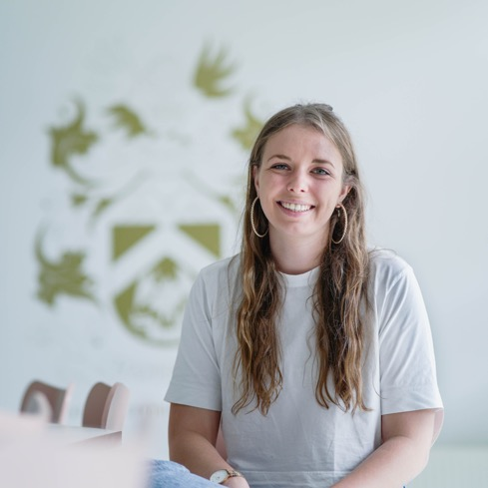
Meet Morgane Juget
Account Executive/Project Coordinator
Work experience
Languages
Account Manager
2023 - present | Happiness Brussels
Account Executive
2021 - 2023 | Happiness Brussels
Digital Content Officer
2019 - 2021 | Thalys
Account Executive Intern
2018 | MRM McCANN - Paris
Morgane is fluent in French & English
Awards
1 CCB Award
1 Effie Award
1 BOA Award
1 Care Award
1 Cannes Lion
“Anything that changes your values changes your behaviour”
Relevant experience
Education
Thalys, VOO, O'Tacos
Master in Digital Marketing & Data Analytics EMLV-IIM - Paris

Slide 26
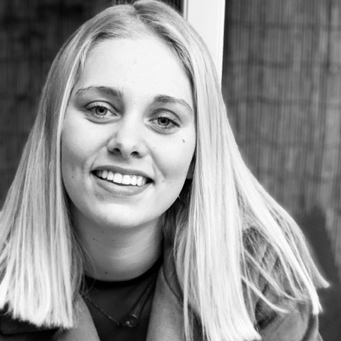
Meet Axelle Verrydt
Account Executive/Project Coordinator
Work experience
Languages
Account Executive
2024 - present | Happiness Brussels
Marketing Intern
2023 | Carlton - Madagascar
Axelle is fluent in Dutch, French and English.
'Anything that changes your values changes your behaviour'
Relevant experience
Education
O’Tacos, Quick
Communication European Communication School - Brussels

